Slide 1
BITCOIN PRICE PREDICTION USING LSTM
Presented by: S.MUTHUKUMAR
III year,KVCET
NM ID-au421221243025 Email id muthukumarcj7@gmail.com

Slide 2


Proposed system
A new system is proposed to revolutionize the industry with advanced features and enhanced efficiency. This innovative solution aims to address existing challenges and elevate operational capabilities to new heights.

Slide 3

Problem Statement
Data Availability
Volatility Challenges
Lack of historical bitcoin price data for accurate predictions.
Extremely volatile nature of cryptocurrency markets.
Noisy Data
Data may contain noise and outliers affecting prediction accuracy.

Slide 4

Proposed solution
Deep learning model: Use LSTM neural network for time series forecasting
Data preprocessing: Normalize, scale, and split the historical Bitcoin price dataset
Model evaluation: Use metrics like RMSE and MAE to assess prediction accuracy

Slide 5
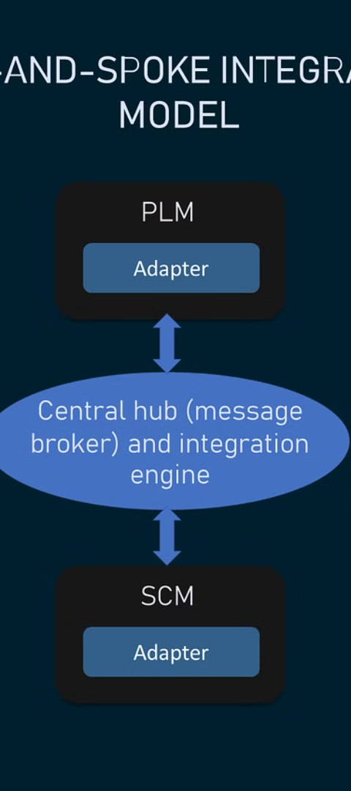
System Approach
1
Understanding the Workflow
Thoroughly examine the current system architecture and data flow.
2
Identifying Modules and Interactions
Break down the system into distinct modules and define how they interact.
3
Integration and Scalability
Design for seamless integration and scalability to accommodate future needs.

Slide 6
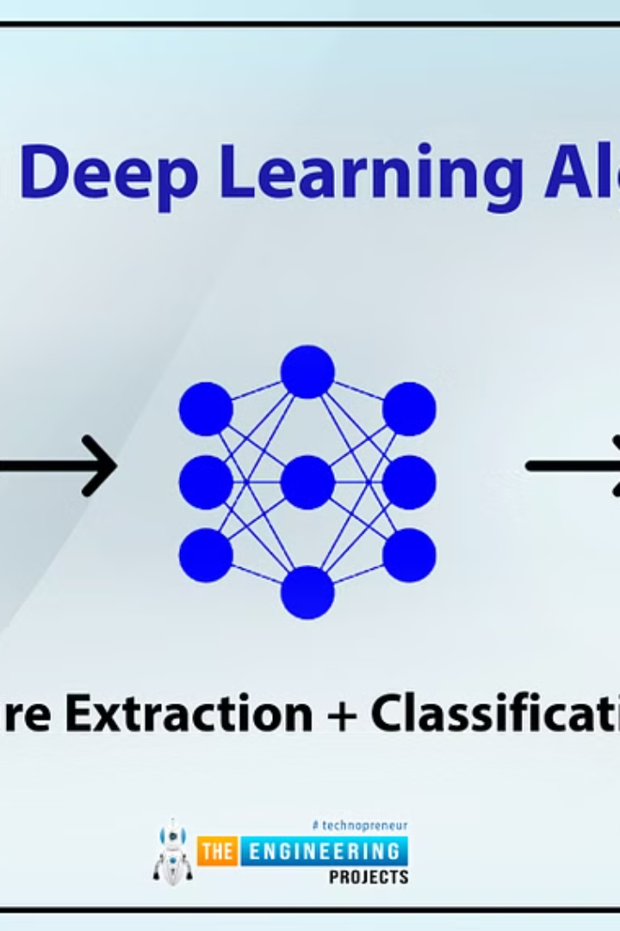
Algorithm and Deployment
After training the LSTM model, the next step is deploying it in a production environment. The deployment process requires careful consideration of hardware infrastructure and platform compatibility. It involves integrating the trained model into the system's architecture and ensuring its seamless functionality.
Additionally, deploying the algorithm involves implementing efficient data pipelines for real-time prediction and monitoring its performance to ensure accurate and reliable results.

Slide 7
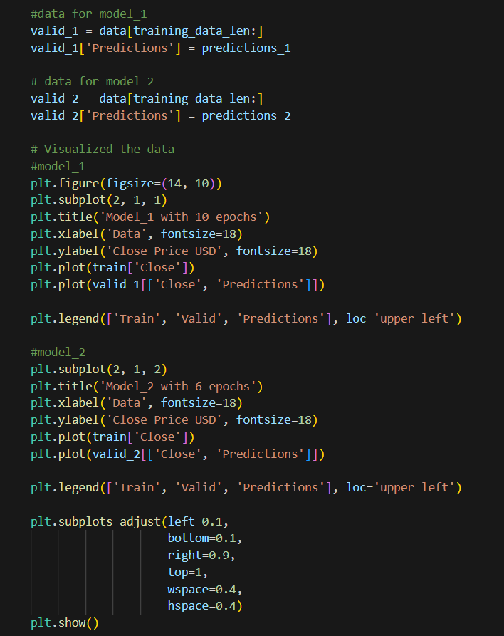
Training and Process
The training of the LSTM (Long Short-Term Memory) model involves feeding historical Bitcoin price data as inputs, adjusting the model's parameters, and testing its performance.
The process includes data preprocessing, model architecture design, hyperparameter tuning, and sequential training-validation-testing iterations.

Slide 8




Prediction Process
Data Collection
Preprocessing
Model Training & Testing
Gather historical Bitcoin price data and relevant external factors.
Clean, normalize, and transform the data for LSTM model input.
Train the LSTM model on historical data and validate its performance.

Slide 9
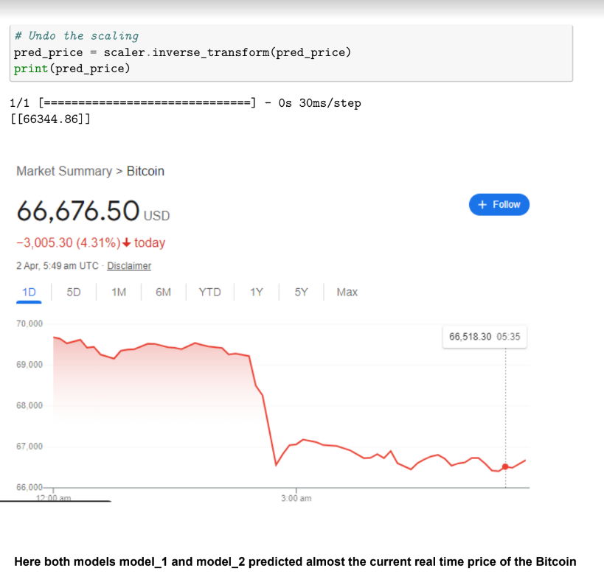
OUTPUT

Slide 10
Result
Model Evaluation
Comparison with Baseline
The accuracy and performance metrics of the LSTM model were evaluated using historical bitcoin price data.
Comparative analysis was conducted to measure the effectiveness of the LSTM model against traditional forecasting methods.
Visualization of Predictions
Forecast Confidence
The predicted bitcoin price trends were visually represented to illustrate the model's effectiveness in capturing the market dynamics.
An assessment of the confidence intervals and uncertainty associated with the model's bitcoin price predictions was performed.

Slide 11



Conclusion Future scope
Advanced models
1
Exploring complex LSTM variations for improved accuracy
Real-time prediction
2
Developing a system for live bitcoin price forecasting
Integration with blockchain
3
Implementing prediction tools directly into blockchain platforms

Slide 12

Reference
For a comprehensive understanding of the concepts discussed, the following references are recommended for further exploration:
Blockchain technology and its applications in finance
Understanding LSTM (Long Short-Term Memory) networks
Predictive modeling and time series analysis in finance

